Slide 1
A Transformer-based Framework for Multivariate Time Series Representation Learning
2/19/2024

Slide 2
Self-supervised learning on multivariate time series
Works well on multitude downstream tasks(classification, regression and imputation)

Slide 3

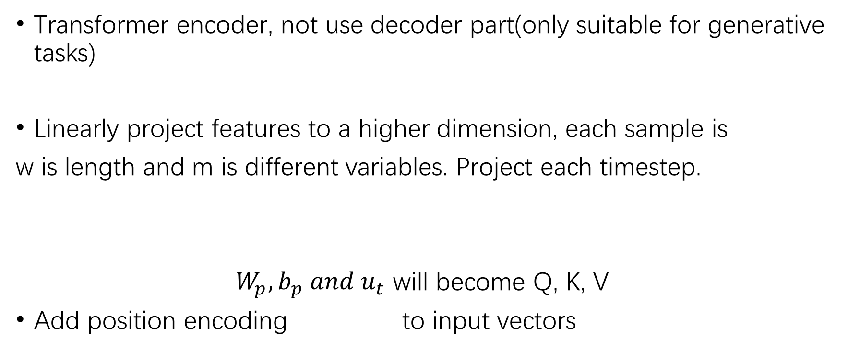
Method
Transformer encoder, not use decoder part(only suitable for generative tasks)
Linearly project features to a higher dimension, each sample is
w is length and m is different variables. Project each timestep.
$W_{p},b_{p} and u_{t}$ will become Q, K, V
Add position encoding to input vectors

Slide 4
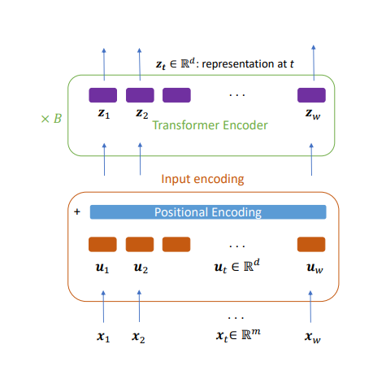
Model
Linearly project features

Slide 5



How to apply on regression
$z_{t}$ is final representation vectors
concate
prediction

Slide 6
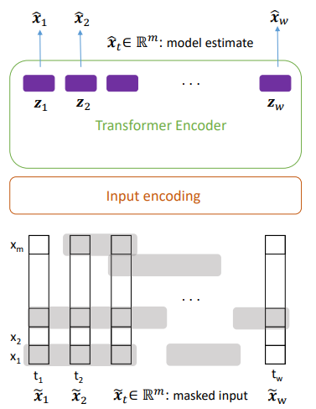
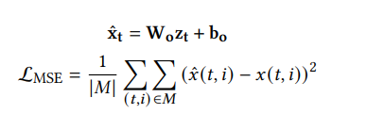


Self-supervised pre-training
Generate binary noise and mask the input
Predict $x$ from $z$
In loss function, only consider masked values
$$M is mask$$

Slide 7
THANKS

